Slide 1
FWD Project
TOGAF 9 - Core Diagrams
Business Footprint Diagram
Phase B – Business Architecture

Slide 2
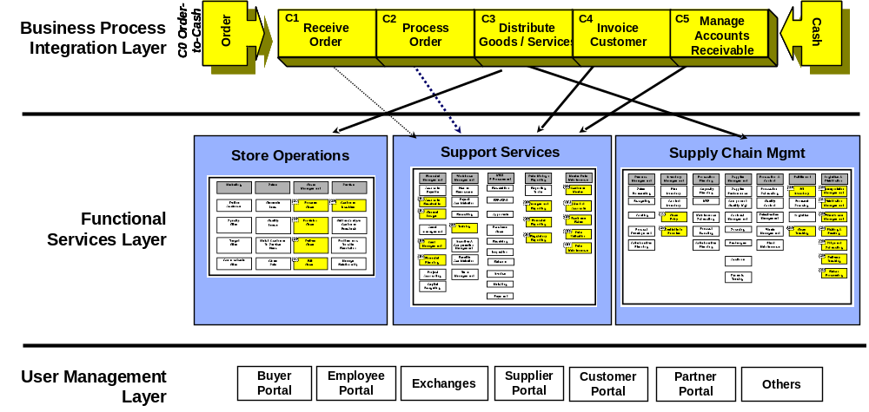
Business Footprint Diagram

Slide 3
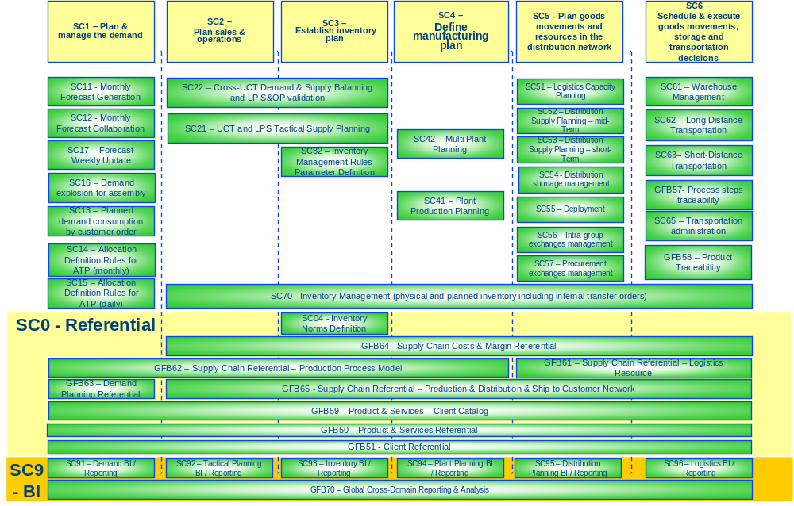
Business Footprint Diagram

Slide 4
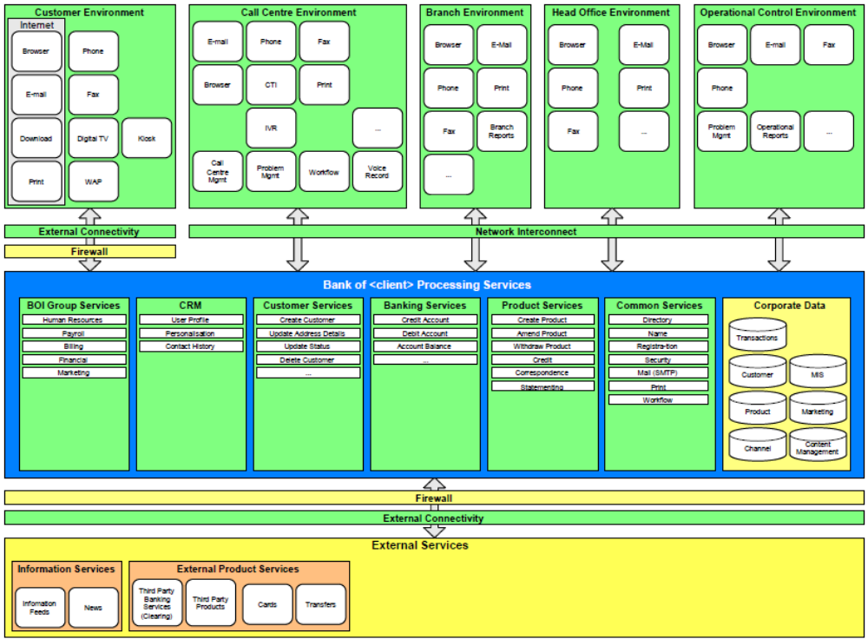
Business Footprint Diagram

